Slide 1
Taking Recommendation Technology To The Masses
Le Zhang | Data Scientist with Microsoft

Slide 2
Outline
Impact of recommendation technology.
Key topics in productizing applicable and scalable recommendation system.
“Fallacies and pitfalls”.

Slide 3

“35% of what consumers purchase on Amazon and 75% of what they watch on Netflix come from recommendations algorithms”
McKinsey & Co

Slide 4


























Recommendation everywhere
Notes:
The AI transformation
Making AI real for customers
How does AI help you? How can you use AI to enable your business today? We have 3 core scenarios that our customers are using today to transform their businesses with AI.
First, we have conversational or digital agents. By 2025, 95% of customer interactions will take place via bots. Bots are a crucial customer engagement tool to build customer loyalty and a competitive advantage for businesses.
Second, we have intelligent apps. Intelligent Apps is about the massive shift around developers and enterprises creating the business apps of the future built around intelligence and data. 75% of apps will be infused with AI by end of 2018.
Third is about transforming core business processes with AI. Every business process in every industry will be transformed by AI. Just as software became the key competitive advantage for companies across industries – the use of AI to get smarter, more agile, and get to market faster will be critical.

Slide 5
Recommendation everywhere
Brand/news/product recommendation
Business metric prediction
Customer segmentation and personalization
Indirectly drive revenue by increasing customer engagement, networking effect, etc.
Directly drive revenue through ad clicks, internet traffics, etc.
Indirectly drive revenue by precisely reaching customers with market campaign or product.
Notes:
The AI transformation
Making AI real for customers
How does AI help you? How can you use AI to enable your business today? We have 3 core scenarios that our customers are using today to transform their businesses with AI.
First, we have conversational or digital agents. By 2025, 95% of customer interactions will take place via bots. Bots are a crucial customer engagement tool to build customer loyalty and a competitive advantage for businesses.
Second, we have intelligent apps. Intelligent Apps is about the massive shift around developers and enterprises creating the business apps of the future built around intelligence and data. 75% of apps will be infused with AI by end of 2018.
Third is about transforming core business processes with AI. Every business process in every industry will be transformed by AI. Just as software became the key competitive advantage for companies across industries – the use of AI to get smarter, more agile, and get to market faster will be critical.

Slide 6
Key pillars of recommendation technologies
Data
Algorithm
Resources
Evaluation
O16N
Time as efforts
https://papers.nips.cc/paper/5656-hidden-technical-debt-in-machine-learning-systems.pdf

Slide 7
Challenges
Limited resource
Fragmented solutions
Fast-growing area
There is limited reference and guidance to build a recommender system on scale to support enterprise-grade scenarios
Packages/tools/modules off-the-shelf are very fragmented, not scalable, and not well compatible with each other
New algorithms sprout every day – not many people have such expertise to implement and deploy a recommender by using the state-of-the-arts algorithms

Slide 8
Implicit preferences.
Computation on sparse matrix.
Data representation.
Time series preferences.
Similarity-based algorithm.
Neighborhood-based algorithm.
Stratification on data splits.
Temporal partition of data.
Missing-at-random.
Long tail distribution.
Funk Singular Value Decomposition.
SVD++.
Restricted Boltzmann Machine.
Deep autoencoder.
Data
Algorithm
Wide & deep.
FM / FFM.
xDeepFM.
Attention mechanism.
Session-based model.
Embeddings.
“Accuracy” based metrics (RMSE, etc.)
Ranking system metrics.
Novelty/Coverage/Serendipity.
Evaluation
O16N
Experimentation protocol
Data splitting
Cold users/items.
Distributed database.
Graph database.
Data lake.
No-SQL database.
Web/mobile application.
Container/K8S cluster
Multi-arm bandit.
Grey-box test, A/B testing, etc.
Business metrics (CTR, impression rate, conversion rate, GMV, DAU/MAU, etc.)
Distributed and parallel computing.
GPU acceleration.
Streaming.

Slide 9
Key pillars of recommendation technologies
Implicit preferences.
Computation on sparse matrix.
Data representation.
Time series preferences.
Data
Algorithm
Evaluation
O16N
Stratification on data splits.
Temporal partition of data.
“Missing-at-random”.
Long tail distribution.
https://arxiv.org/ftp/arxiv/papers/1205/1205.2618.pdf
http://yifanhu.net/PUB/cf.pdf
https://link.springer.com/chapter/10.1007/978-1-4899-7637-6_8
https://arxiv.org/ftp/arxiv/papers/1206/1206.5267.pdf

Slide 10
Data in a recommender system
How do users interact and how is data collected?
Explicit feedback
Ratings – e.g., numerical ratings of movies on IMDB or Netflix.
Survey results – e.g., survey on items with rating, satisfaction level, etc.
Reviews – e.g., text reviews with positive or negative sentiment.
Implicit feedback
Click / no click
Purchase / no purchase
#clicks, #purchases, #pointing links
User engagement
CTR / conversion rate / impression / attempt
Other data (features) about users and items available
Knowledge-based data (as opposed to historical data), e.g. user requirements, goals etc.

Slide 11
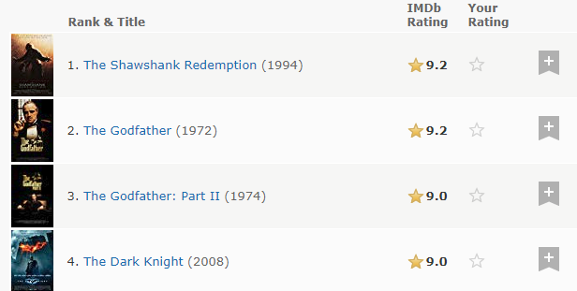
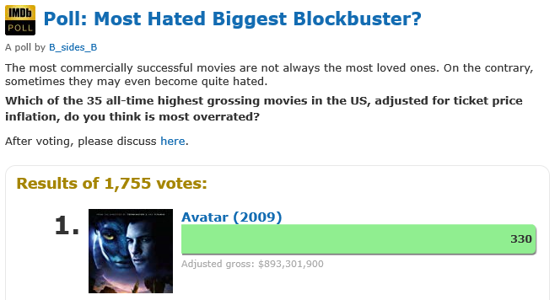
Explicit feedback
Pros
Can be more informative and richer
Allows for active learning
Cons
May be costly to obtain
Inconvenient to users
Biased towards certain users
May need calibration (ratings may not be easily comparable)

Slide 12
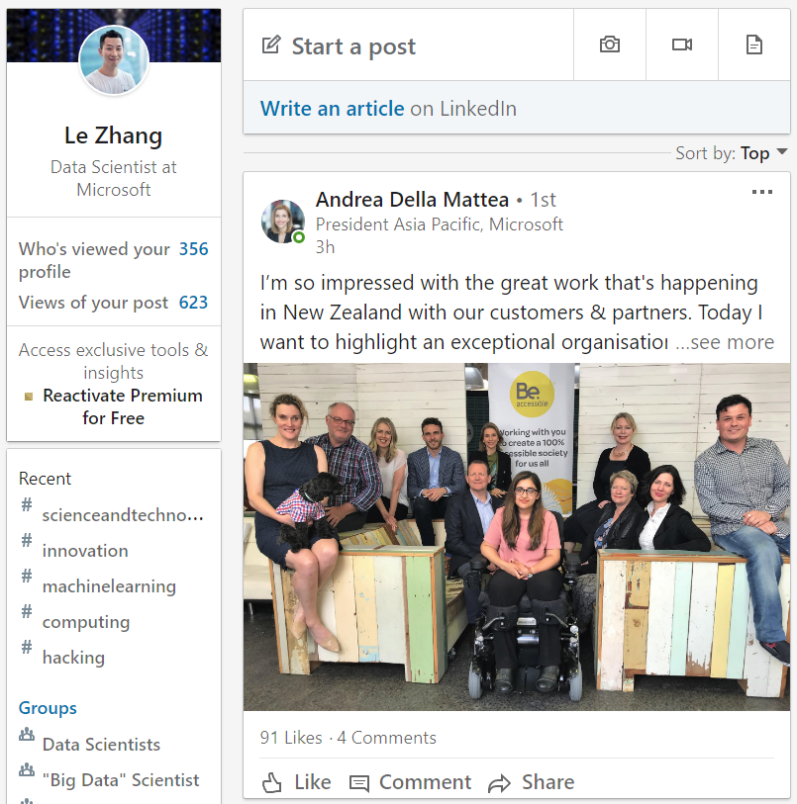
Implicit feedback
Pros
Often readily available from transaction logs
Not disruptive to users → more data points
Less statistical bias, more representative of customer base
Cons
Often less graded (e.g. click / no click), less personalized (e.g. CTR)
Hard to define and find negative samples
Explicit feedback to the feed updates – “like”,
and implicit feedback such as clicks on the feed, time spent on the feed, etc.
Y Hu et al, Collaborative filtering for implicit feedback datasets
X He et al, Fast matrix factorization for online recommendation with implicit feedback

Slide 13
Key pillars of recommendation technologies
Similarity-based algorithm.
Neighborhood-based algorithm.
Funk Singular Value Decomposition.
SVD++.
Restricted Boltzmann Machine.
Deep autoencoder.
Data
Algorithm
Evaluation
O16N
LR.
XGBoost.
LightGBM
Wide & deep.
FM / FFM.
xDeepFM.
Attention mechanism.
Session-based model.
Embeddings.
https://github.com/yueguoguo/production-ready-recsys
https://www.microsoft.com/en-us/research/lab/microsoft-research-asia/articles/personalized-recommendation-systems/?from=timeline&isappinstalled=0

Slide 14
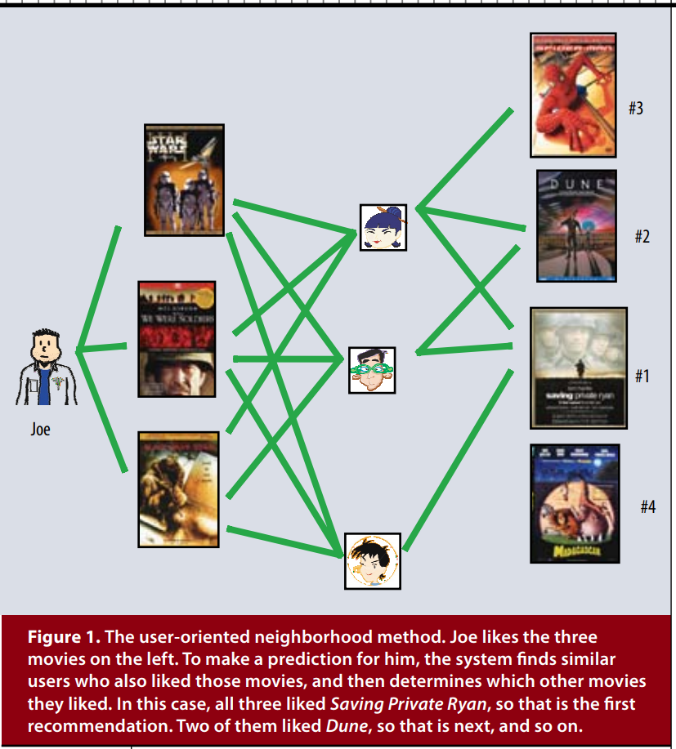
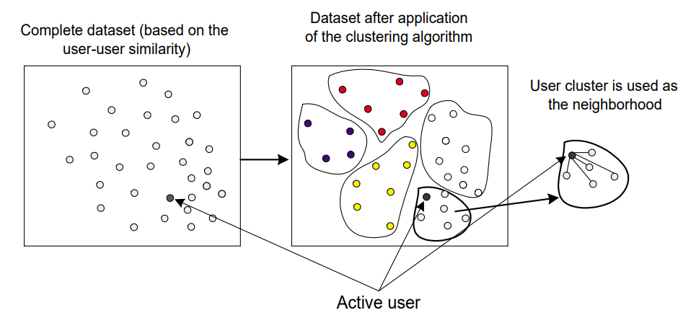
Memory based method
User based collaborative filtering algorithm
Neighborhood based algorithm
Find similar items to the ones that a user likes
Nearest neighbors
Clustering algorithm
https://www.microsoft.com/en-us/research/wp-content/uploads/2016/02/tkde_collabfiltering.pdf
Y Koren et al, Matrix factorization techniques for recommendation systems, IEEE Computer 2009
B Sarwar et al, Recommender systems for large-scale e-commerce, scalable neightborhood formation using clustering, 2002

Slide 15
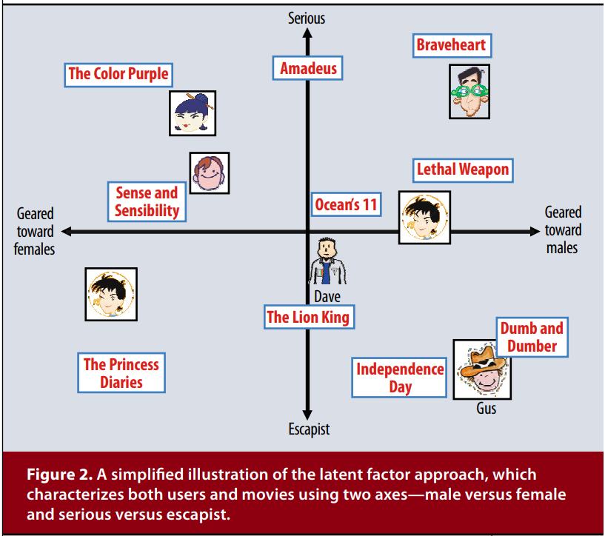
Matrix factorization
Latent factors
Try to explain the ratings by characterizing all users and items in a more global way, i.e., latent factors
The item factors weight the items in ways that may reflect e.g. comedy vs. drama, or uninterpretable dimensions
The user factors weight the users’ preferences towards the item factors
Y Koren et al, Matrix factorization techniques for recommendation systems, IEEE Computer, 2009

Slide 16
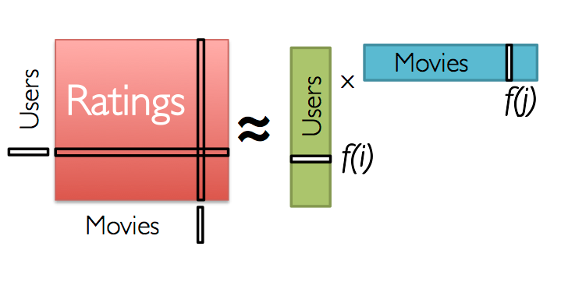
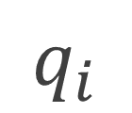

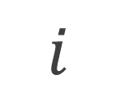

Matrix factorization
The simplest way to model latent factors is as user & item vectors that multiply (as inner products)
Learn these factors from the data and use as model, and predict an unseen rating of user-item by multiplying user factor with item factor
The matrix factors U, V have f columns, rows resp.
The number of factors f is also called the rank of the model
$$q_{i}$$
$$u$$
$$p_{u}$$
$$i$$
https://www.datacamp.com/community/tutorials/matrix-factorization-names

Slide 17
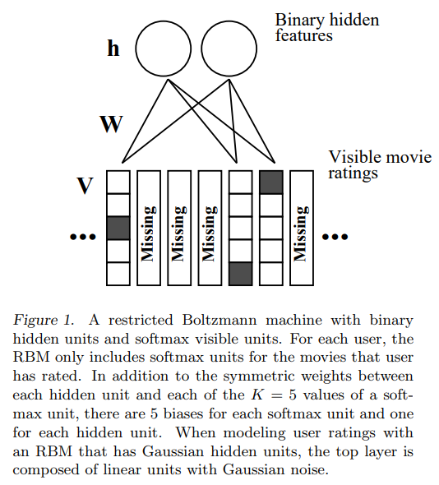
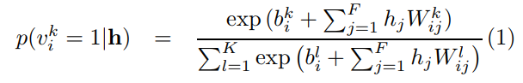
Restricted Boltzmann Machine (RBM)
RBM method
Outperformed Netflix existing method (SVD based)
Idea
Two-layer undirected graph model
Visible and hidden layer pair to model user preferences
Visible layer (existing ratings)
Hidden layer (features)
Model conditional distribution of visible ratings
Suitable for large data, e.g., Netflix (over 100mil ratings)
https://www.cs.toronto.edu/~rsalakhu/papers/rbmcf.pdf
Notes:
To solve problem of sparsity and non-convex. Softmax for multinomial case of RBM. The typical construction of RBM is binomial.
Each user one RBM with M softmax units connected to a set of binary hidden units. The RBM is to use conditional multinomial distribution to model probability of a softmax output given the condition of hidden layer user features.

Slide 18
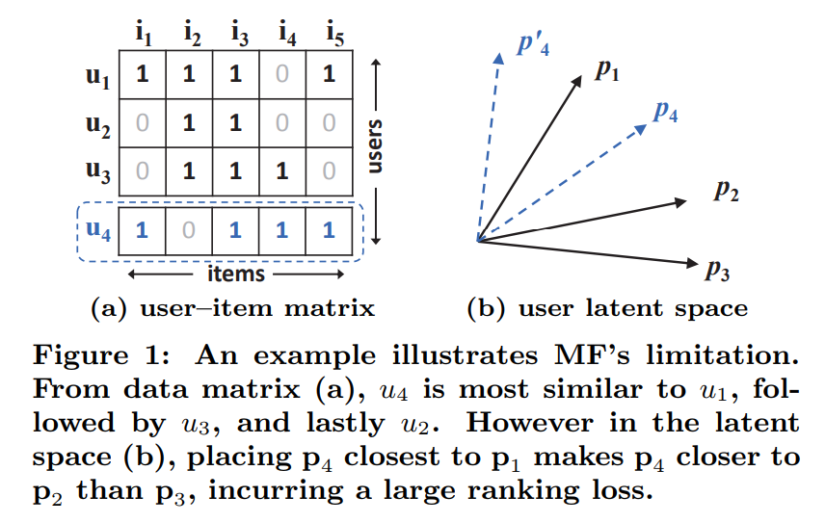
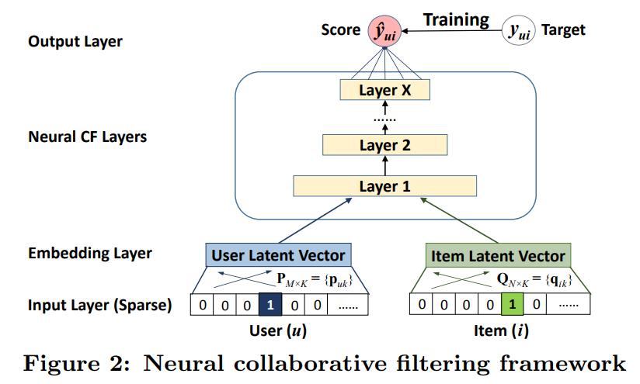
Neural collaborative filtering (NCF)
Neural collaborative filtering
Neural network-based architecture to model latent features
Generalization of MF based method
Multi-Layer Perceptron (MLP) can be incorporated for dealing with non-linearities
X He et al, Neural collaborative filtering, WWW 2017

Slide 19
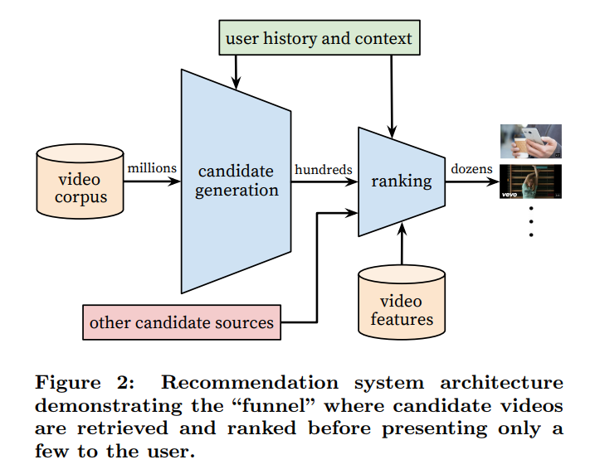
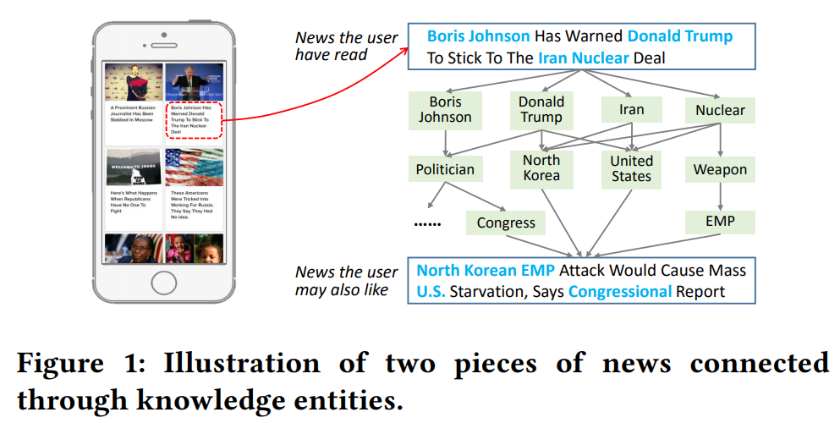
Content-based algorithms
Content-based filtering methods
“Content” can be user/item features, review comments, knowledge graph, multi-domain information, contextual information, etc.
Mitigate the cold-start issues in collaborative filtering typed algorithms
Personalized recommendation
Location, device, age, etc.
H Wang et al, Deep knowledge aware network for news recommendation, WWW 2018
J Davidson et al, The YouTube video recommendation system, RecSys 2010

Slide 20
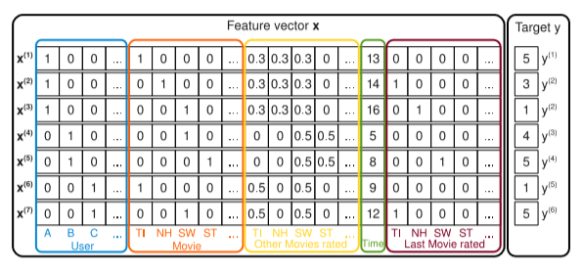
Factorization machine (FM)
FM extends matrix factorization to model interactions of order > 2 and incorporates features
Encodes the users and items with one-hot indexes
The input x contains users, items and their features as a single vector
Instead of a product of matrix factors, there is a single matrix variable V; some rows of V correspond to users, some to items and the rest to features
S Rendle, Factorization Machines, ICDM 2010

Slide 21
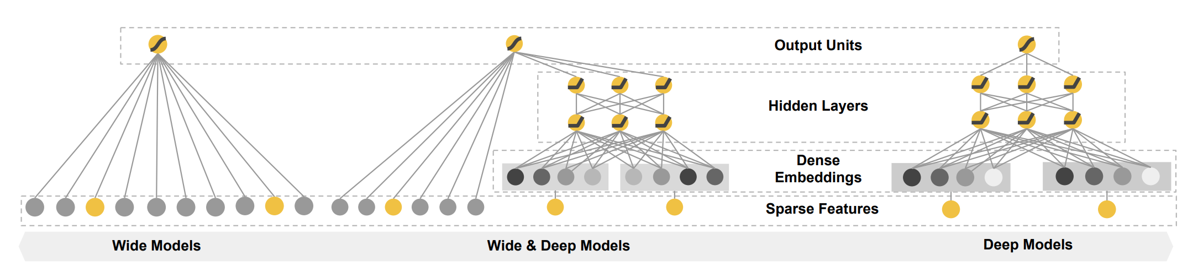
Wide and deep
HT Cheng et al, Wide and deep learning for recommendation systems, DLRS 2016
Notes:
Large-scale recommendation & ranking system – logistic regression is used because it is simple, explainable, and scalable
Wide part – generalization. Cross-product transformation; add non-linearity to the feature modeling
Deep part – memorization. Learning high-d inputs (via low dimensional embeddings)

Slide 22
Fallacies and pitfalls
“Complex algorithms are always preferred.”
Run time performance
Run time performance
Algorithm #1
Algorithm #2
Explainability
Scalability
Explainability
Scalability
Model performance
Model performance
https://www.microsoft.com/en-us/research/lab/microsoft-research-asia/articles/personalized-recommendation-systems/?from=timeline&isappinstalled=0
https://arxiv.org/abs/1804.11192
https://arxiv.org/abs/1706.07639

Slide 23
Key pillars of recommendation technologies
“Accuracy” based metrics (RMSE, etc.)
Ranking system metrics.
Novelty/Coverage/Serendipity.
Experimentation protocol
Data splitting
Cold users/items.
Data
Algorithm
Evaluation
O16N
Multi-arm bandit.
Grey-box test, A/B testing, etc.
Business metrics (CTR, impression rate, conversion rate, GMV, DAU/MAU, etc.)
https://link.springer.com/chapter/10.1007/978-1-4899-7637-6_8
https://dl.acm.org/citation.cfm?id=3240354

Slide 24
Fallacies and pitfalls
“Good metrics indicate good recommenders.”
Accuracy
Ranking
Online metrics
Revenue
Order of the recommended item list.
Correlation?
Correlation?

Slide 25
Key pillars of recommendation technologies
Distributed database.
Graph database.
Data lake.
No-SQL database.
Data
Algorithm
Evaluation
O16N
Distributed and parallel computing.
GPU acceleration.
Streaming.
Web/mobile application.
Container/K8S cluster
https://kubernetes.io/
https://dl.acm.org/citation.cfm?id=214456
https://spark.apache.org/docs/latest/mllib-collaborative-filtering.html
https://docs.microsoft.com/en-us/azure/cosmos-db/introduction

Slide 26
Reference Architecture on Azure
Scalable end-to-end personalized service
Recommendations with user/item features
Serving a model for real time scoring and recommending
https://docs.microsoft.com/en-us/azure/architecture/example-scenario/ai/scalable-personalization
Real-time recommender
Collaborative filtering typed recommendations
Serving recommendation results
https://docs.microsoft.com/en-us/azure/architecture/reference-architectures/ai/real-time-recommendation
Knowledge-graph based recommender

Slide 27
Reference Architecture on Azure
Scalable end-to-end personalized service
Recommendations with user/item features
Serving a model for real time scoring and recommending
https://docs.microsoft.com/en-us/azure/architecture/example-scenario/ai/scalable-personalization
Real-time recommender
Collaborative filtering typed recommendations
Serving recommendation results
https://docs.microsoft.com/en-us/azure/architecture/reference-architectures/ai/real-time-recommendation
Knowledge-graph based recommender

Slide 28
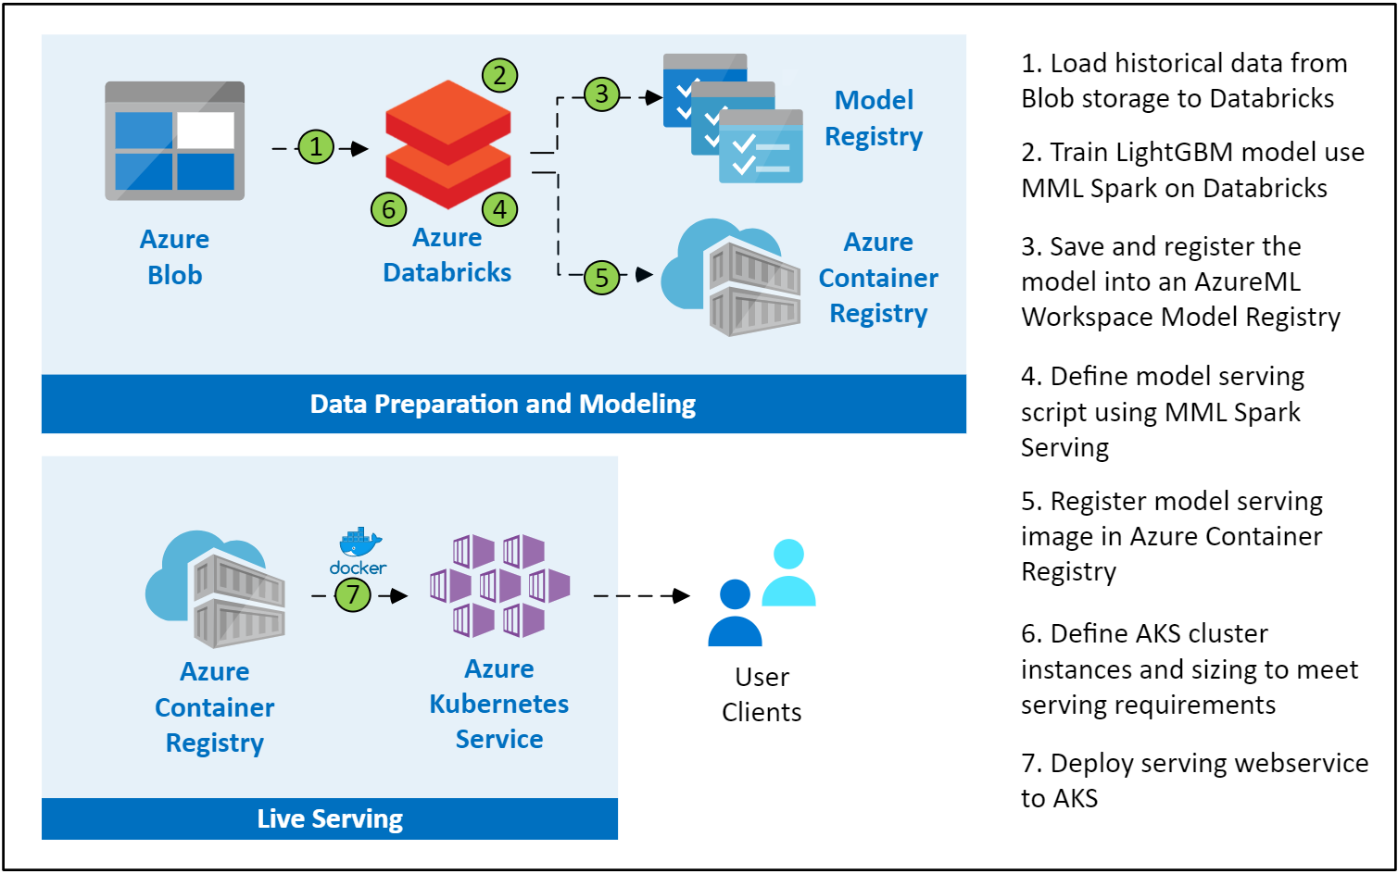
Scalable Personalization Workflow

Slide 29
Scalable Personalization
Azure blob storage
Massive scalable object storage for unstructured data
Used for preserving raw/processed data
Geo-redundant for enhanced global access

Slide 30
Scalable Personalization
Azure Databricks
Fast, easy, and collaborative Apache Spark based analytics service
Spark based workloads
Data preprocessing like feature generation, data split, etc.
Spark based model building and scoring

Slide 31
Scalable Personalization
Azure Kubernetes Services
Highly available, secure, and fully managed Kubernetes service
Serving either the model for real-time recommender results, or pre-cached recommendation results
Performance specs vs K8S cluster configuration

Slide 32
Distributed DB needed?
Parallel / distributed?
No
DSVM
App service needed?
Yes
Yes
O16N pipeline
CosmosDB
Databricks
Yes
DSVM (GPU)
Yes
ACI/AKS
Workflow
Data
Recommender
Evaluator
Chrono split
NN-based
DeepRec
Diversity
Stratified split
Yes
Content-based
No
Regression
Ranking
No
Yes
Random split
Even richer feature set?
ALS
No
Rating
Analyitcs pipeline
Yes
No
Yes
Time dependent?
collaborative filtering
SAR
Diversity metrics?
No
Yes
No
No
Yes
No
No
Cold start user/item?
User/item features?
Similarity based?
Ranking evaluation?

Slide 33
Open Source Best Practices
Microsoft/Recommenders
Collaborative development efforts of Microsoft Cloud & AI data scientists, Microsoft Research researchers, academia researchers, etc.
Github url: https://github.com/Microsoft/Recommenders
Contents
Utilities: modular functions for model creation, data manipulation, evaluation, etc.
Algorithms: SVD, SAR, ALS, NCF, Wide&Deep, xDeepFM, DKN, etc.
Notebooks: HOW-TO examples for end to end recommender building.
Highlights
4600+ stars on GitHub
Featured in YC Hacker News, O’Reilly Data Newsletter, GitHub weekly trending list, etc.
Any contribution to the repo will be highly appreciated!
Create issue/PR directly in the GitHub repo
Send email to RecoDevTeam@service.microsoft.com for any collaboration

Slide 34
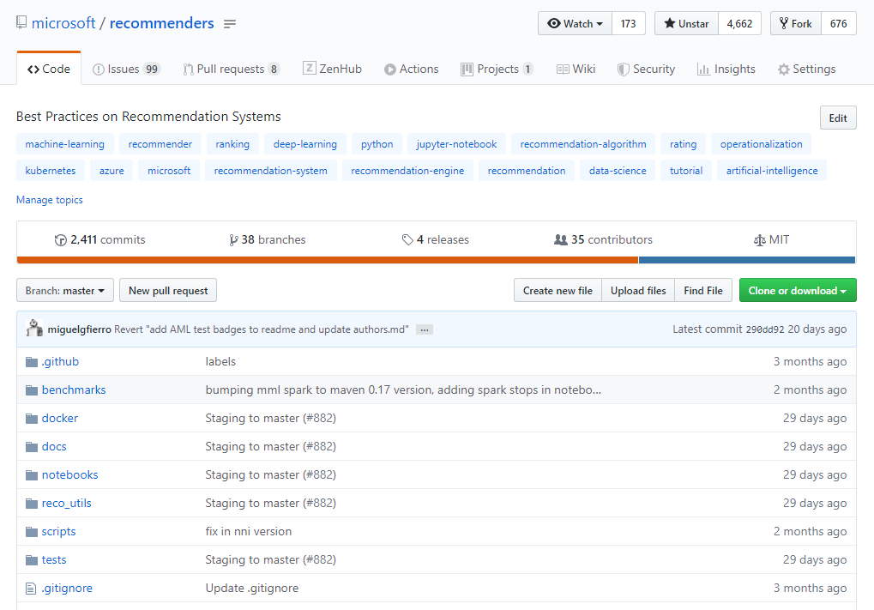
Microsoft/Recommenders

Slide 35
Summary
The ultimate goal of a recommender system is to predict user preferences instead of to optimize root mean squared error
Building a recommender system for industry-grade applications requires in-depth understanding of data preparation, evaluation, recommending algorithm, and model operationalization
A deployed recommender system should always be up-to-date along with the change of data (characteristics), business scenarios, operationalization pipeline, etc.
Recommender system is built by using a blend of many technologies, e.g., deep learning, parallel computing, distributed database, etc.

